Slide 1

A Parent’s Guide to School Communication
Madison Public Schools
October 2012

Slide 2
How do we communicate?
At Madison Public Schools we have different tools which are used to communicate information to parents.
Feel free to click on a subject below to jump to it:
  Finalsite (websites)
  Mobile Website (from a cell phone or iPod device)
  eNotify (email messages)
  Backpack Express & Announcements (emailed flyers)
  Infinite Campus (grades and attendance)

Slide 3

finalsite

Slide 4
finalsite
What is finalsite?
Elementary School: teacher webpages. Access the teacher’s website through the staff directory
Grades 5 – 12: Class webpages. Access class webpages by logging in.
www.madison.k12.ct.us

Slide 5


My Child is in
Elementary School…
Find the teacher’s website using the staff directory.
Then click on “website” near the teacher’s name.

Slide 6
What will I find on the elementary webpage?
Teachers may display information on their pages such as:
  Classroom overview
  Bulletins – reminders and notices of things going on in class
  Calendar – for homework, trips, quizzes, projects
  Resources – file folders of links to other websites, hand-outs, study guides

Slide 7
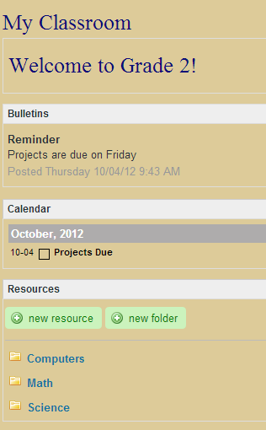
Elementary Webpages
Teachers post information to keep Parents and Students informed about what is happening in school

Slide 8

My Child is in
Middle School or High School…
Webpages for the middle school and high school classes are inside the portal. Teachers, Students, and Parents login to view this space. Students will interact with this space.
How do I login to the finalsite portal?
On any of our webpages click on COMMUNITY LOGIN
Use the login id and password you received in the mail.
Each household has one login for the parents to share.
Students have their own login credentials.

Slide 9
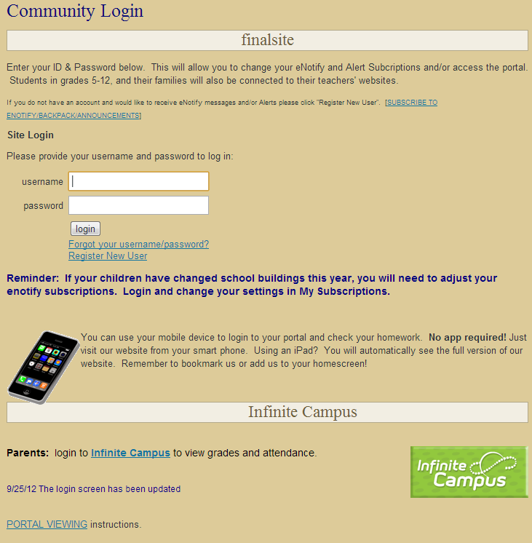
Community Login
Login here for finalsite (classroom webpages)

Slide 10
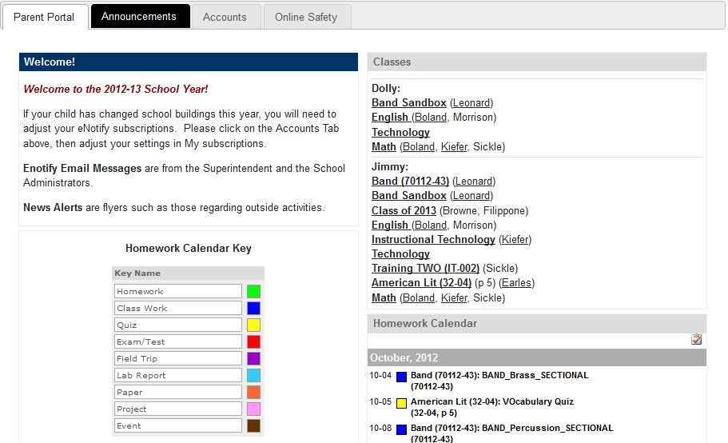
What will I find after I login?
Notes to Parents
Classes for all of your children in MS & HS
One calendar displays all homework for all of your children.

Slide 11
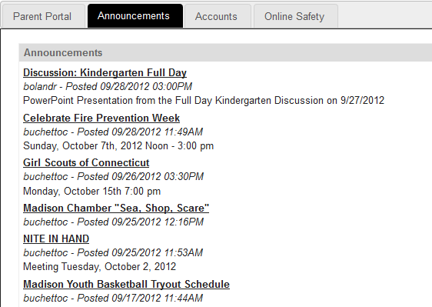
Announcements Tab
The Announcements tab displays all news posts from the District homepage as well as any flyers from organizations that might be of interest

Slide 12
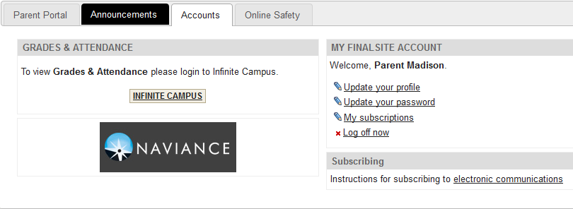
Accounts Tab
Update your profile: edit your email address if necessary
Login to other websites
Update passwords or subscriptions in finalsite

Slide 13
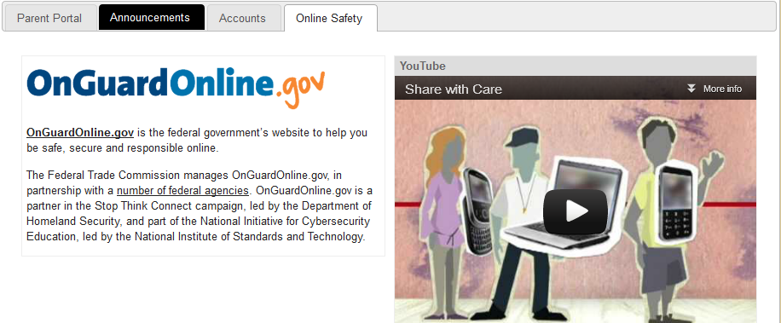
Online Safety Tab
Online safety tips for parents

Slide 14
View Classroom Spaces
Click on the name of the class you wish to view
How do I see the teacher classroom pages?

Slide 15
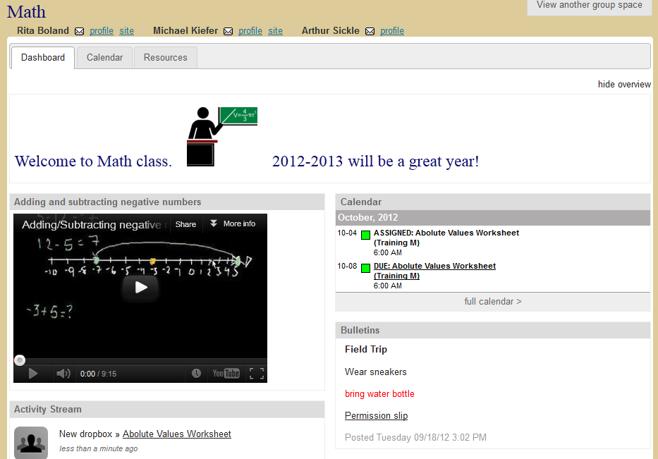
Classroom Spaces
Information about the class
Homework Calendar
Recent updates to the page
Posted notices from the teacher

Slide 16
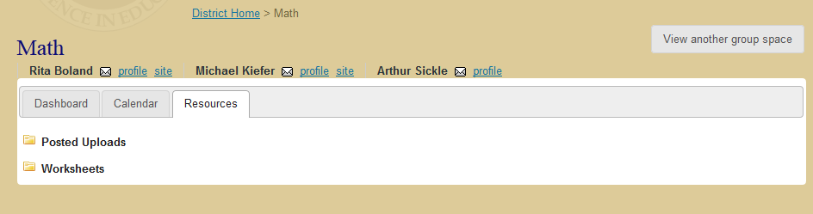
Classroom Spaces
Switch to a different class
A
B
The calendar tab will show the homework for this class
B. The resources tab will display folders of worksheets, handouts, and websites the teacher is sharing with the class.

Slide 17
Login Credentials
What do I do if I forget my password?
Students should speak to a teacher or anyone in their school office.
Parents with an email address on file can click “Forgot your username/password?” located under the login button to have information recovered by email. If an email address is not on file, call the school main office to have your password reset.
Reset information will be mailed to the house, never over the phone or by email.

Slide 18
Mobile Website

Slide 19


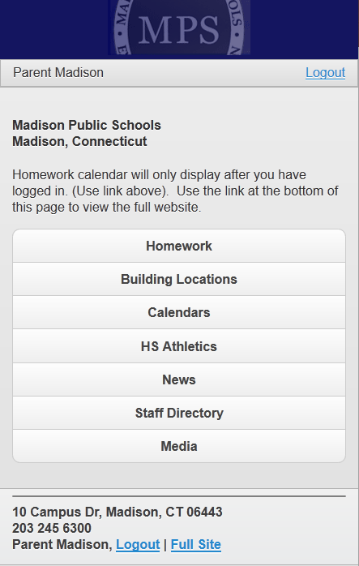
Mobile Website
All student homework (Grades 5- 12) can be viewed on one screen
Visit the school website from your mobile device
1. Login
2. Click on Homework
Remember to bookmark us for future use!

Slide 20
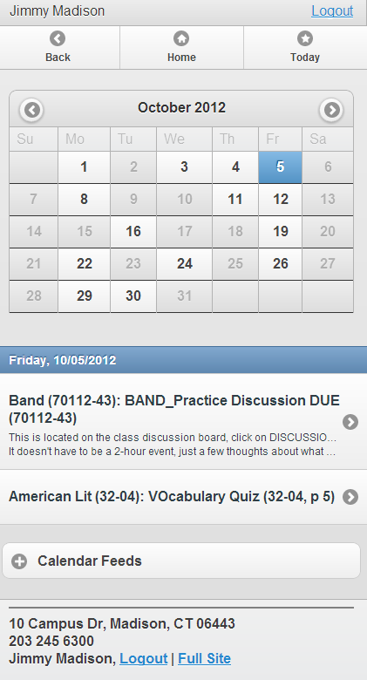
Click on the calendar date you want to view
Homework and events will appear under the calendar grid for the date you clicked on.
You can click “Full Site” if your mobile device can easily handle internet webpages

Slide 21
eNotify

Slide 22
eNotify
eNotify email messages are from the Superintendent’s office, or the Principal’s office regarding school business.
If you have a Parent’s portal account, you can use it to subscribe.
If you don’t have a parent account, you will have the opportunity to create a public account.

Slide 23
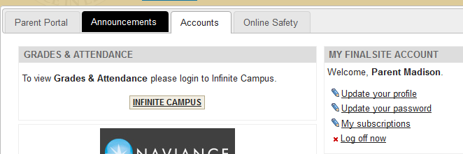
If you already have a parent account…
Login to the finalsite portal
Click on the Accounts tab

Slide 24
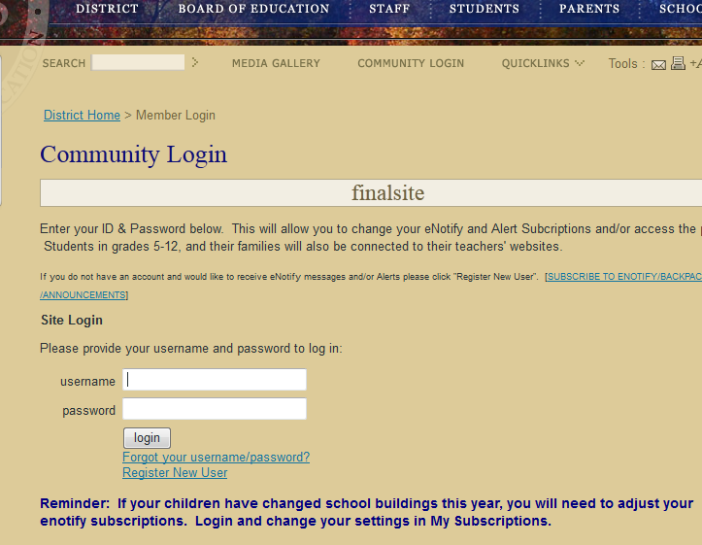
If you need to create an account
Click on COMMUNITY LOGIN on any of our webpages
Click Register New User (found under the login button)

Slide 25
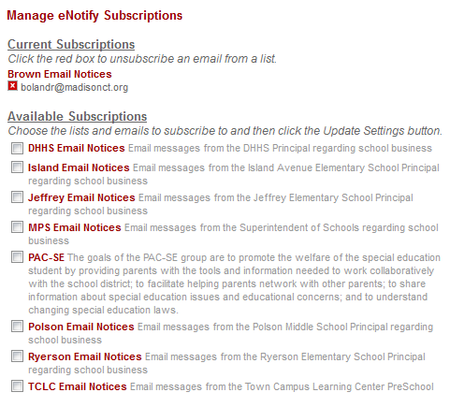
Subscribe to eNotify
Click on My Subscriptions
Click Settings next to Email Mailing Lists
Check the box next to any notices you wish to receive
Click Update Settings to finish

Slide 26
Backpack Express
&
Annoucements

Slide 27

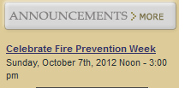
Backpack Express
& Announcements
When you subscribe to Backpack Express (lower grades) and Announcements (upper grades) you will receive information emailed to you about community activities such as PTO, scouts, and sports.
This same information can also be viewed on each school’s homepage

Slide 28
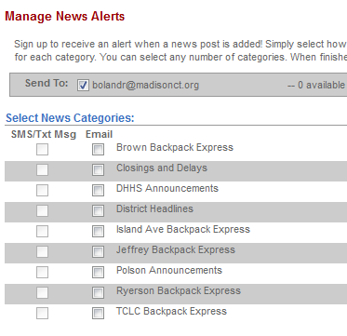
Subscribe to Backpack Express & Announcements
Login to Community Login
Click My Subscriptions (Portal parents will need to click on the Accounts tab.)
Click Settings next to News Alerts
Check the box next to the alerts you wish to receive

Slide 29

Text Messages
You can choose to receive a text message when the school day is altered.
This service is free but you may be charged by your cell provider.
Please check your cell service plan to find out if you will incur charges for receiving text messages.
Early Dismissal

Slide 30

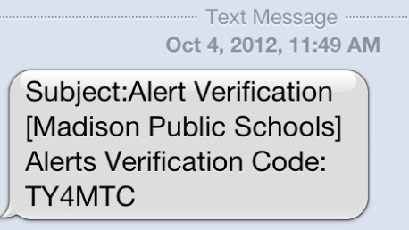

Text Messages
Login on the COMMUNITY LOGIN page
Click My Subscriptions to add your cell phone number. Please be certain to select your cell carrier.
Your phone will receive a text message that includes a code. Enter the code by clicking on Verify.

Slide 31
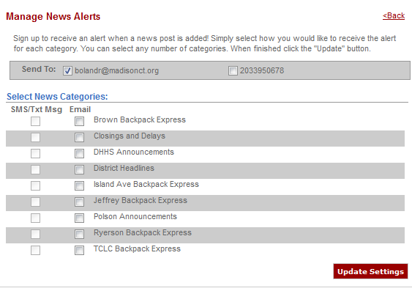
Text Messages
3. Then chose what to receive by text
2. Check this box
Click on "Settings" next to News Alerts
In the SEND TO field choose your cellphone.
In Select News Categories check the box for SMS/Txt Msg next to Closings and Delays
Click update settings.
(555)555-1212
Select “Closings & Delays”

Slide 32

Infinite Campus

Slide 33
Infinite Campus
Infinite Campus is used to see information about your child, including:
Attendance information
Grades

Slide 34
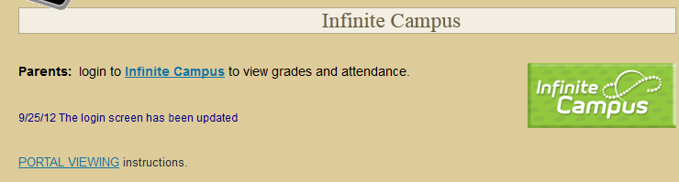
How to Login
Visit the Madison Public School’s website www.madison.k12.ct.us
Click COMMUNITY LOGIN on any of our webpages
Scroll down to the Infinite Campus link
Enter your user name and password is the space provided.

Slide 35
Community Login
Login here for Infinite Campus (grades & attendance)

Slide 36
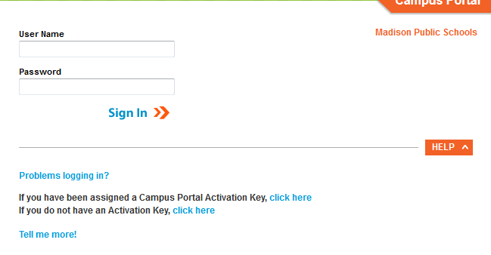
First Time Users
The first time you login you must create a user ID and password
Click the HELP button on the page to expand that section
Click to enter your Portal Activation Key in the space provided.

Slide 37
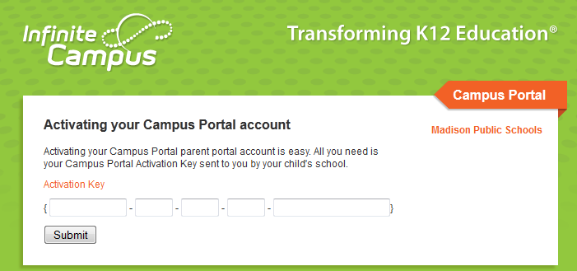
Enter your Activation Key code from the letter you received in the mail to create your online profile.
*Please keep this information in a safe place. Infinite Campus passwords are not recoverable. If you forget or lose your login id & password, you will need to contact the school to have your accounts reset. A letter mailed to your home with activation instructions. New credentials are never issued over the phone or through email.

Slide 38
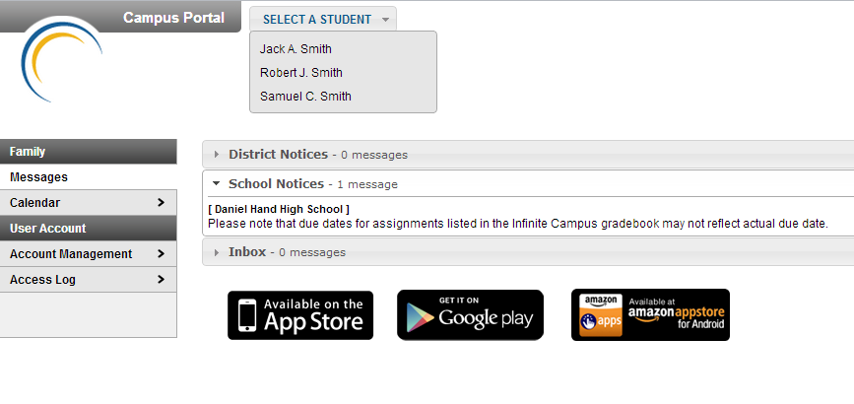
Login & Select which student to view
Choose which child to view.
Jimmy Madison
Dolly Madison

Slide 39
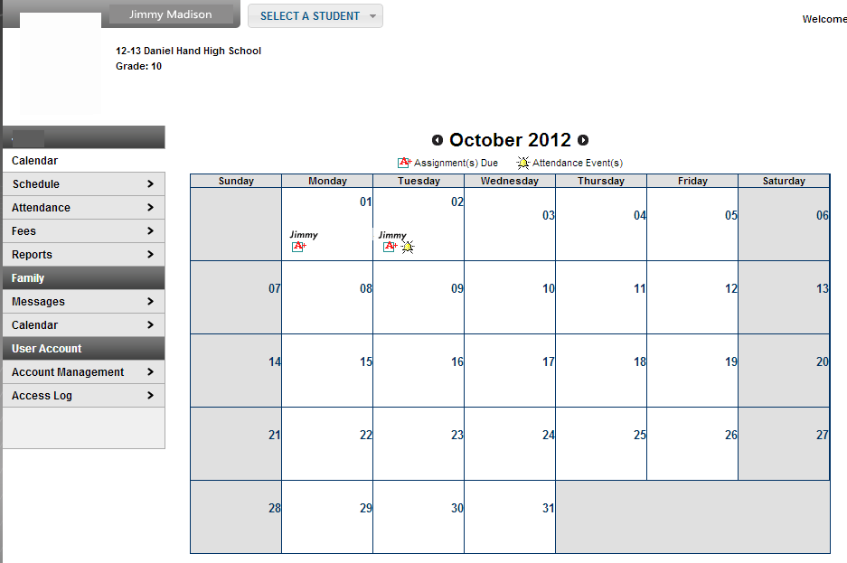
Student Selected
Click the A+ symbol to view grade received
Click the bell to view attendance events

Slide 40
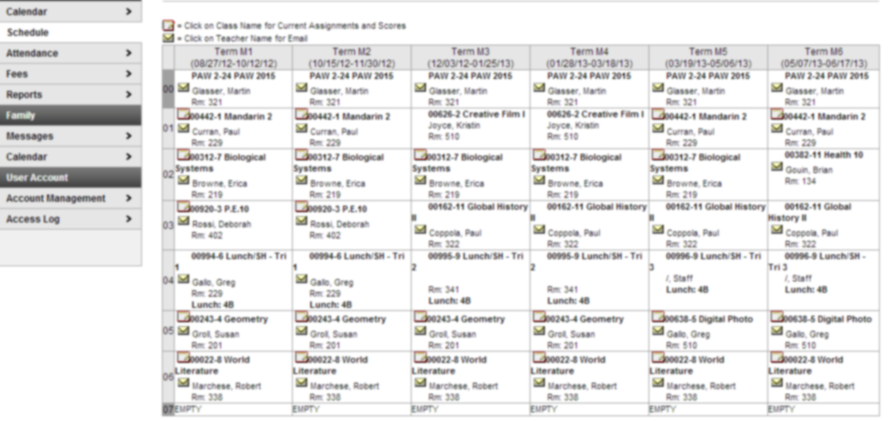
Now you can click on the course name to view assignments and grades
Click the teacher’s name to send an email
Click Schedule

Slide 41

If you have questions send an email to webmaster@madison.k12.ct.us

